Slide 1
BMC Cyber and Cloud Summer Courses Deep Learning for Computer Vision Course Overview
Samuel Adebayo
sadebayo@belfastmet.ac.uk

Slide 2
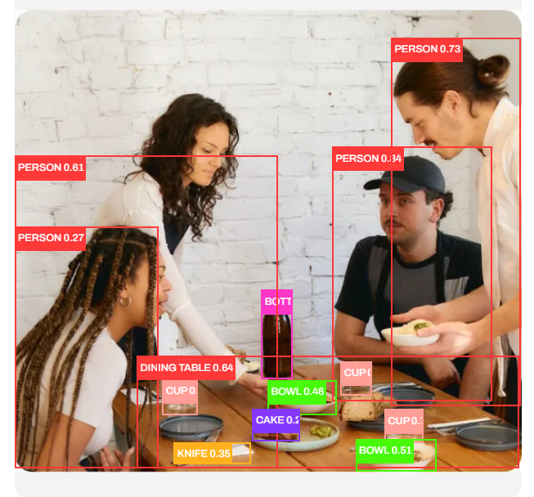
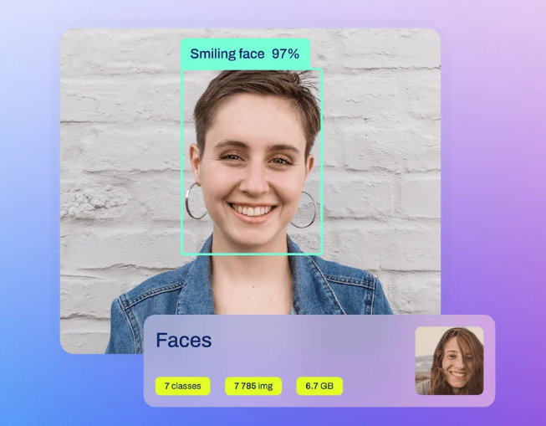
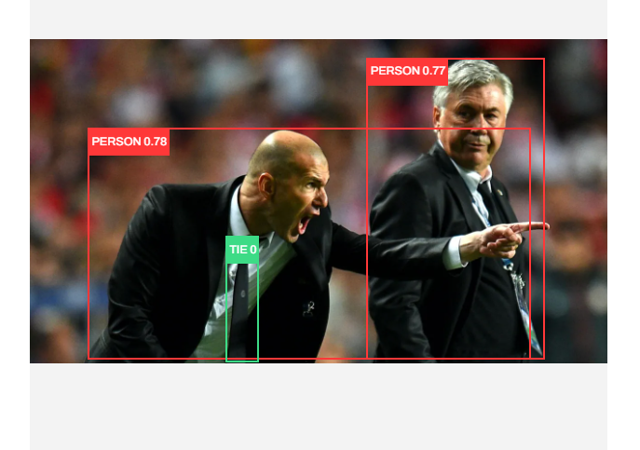

Slide 3
Course Objectives
Gain a foundational understanding of deep learning concepts.
Learn to implement various Computer Vision models using TensorFlow/PyTorch.
Explore advanced topics like Image classification, Object Detection, and pose estimation.
Engage in hands-on projects to reinforce learning.

Slide 4
Course Structure
4 Days in Total
Each day includes both lectures and hands-on sessions.
Day 4 will focus on QA/revision.

Slide 5
Day 1 Overview
Introduction to Python
Introduction to Deep Learning
Basics of Computer Vision
Introduction to Convolutional Neural Networks (CNNs)
Hands-On: Basic Image Classification using CNNs

Slide 6
Day 2: Overview
Advanced CNN Architectures
Transfer Learning and Fine-Tuning
Hands-On: ResNet and Transfer Learning

Slide 7
Day 3: Overview
Object Detection
Pose Estimation
Hands-on; Object Detection and Pose Estimation

Slide 8
Day 4: Overview
Revision and Q&A

Slide 9
Tools and Resources
Software: Pytorch, OpenCV
Datasets: MNIST, CIFAR-10, COCO, RAF-FACE, Animals (Cats, Dogs, Pandas)
Jupyter Notebook or Google Colab

Slide 10

Thank You
See you soon

